Slide 1

Sneha
Khanh Dao
Tran Pham
Mohamad

Slide 2

CMPE 281 - Term Project Mobile Sensor Cloud Infrastructure
SJSU Washington Square
Agenda
Introduction
Project Features
Design Concept
Detail Component Design
Demo
Notes:
Tran

Slide 3

Introduction
SJSU Washington Square
Smart city transportation
Mobile Sensor Cloud Infrastructure
Vision
Notes:
Transportation is a big issue for any densely populated cities. The traditional solution is to build more lanes to the road. This is a costly solution and become ineffective over time. Another solutions is to raise the efficiency of using existing infrastructure, or smart city transportation. This can be achieved by combining sensor data on public transportation with new cloud technology & big data to help analyze the data and develop effective solutions.
In this project, we focus on building a Mobile Sensor cloud infrastructure (Iaas). The IaaS is capable of setting up, control, and management of mobile sensor as an on-demand service.
Bus Cloud will act as enabler, bring sensor data of bus network closer to the software development community. Sensor Data such as location sensor, temperature sensor, air pollution sensor, speed sensor..etc can be utilised to develop various smart applications
Transportation vehicle tracking: determine what time bus will arrive at the bus stop/ train station.
Bus’ seats availability: show available seats in the coming bus
Bus allocation: determine the peak hours at certain locations to provide more public vehicles for the peak hours.
We hope such smart software solutions in near future will help us raise the efficiency of our public transportation. Once smart city transportation work effectively, it will help reduce the traffic congestion, air pollution and parking places.

Slide 4
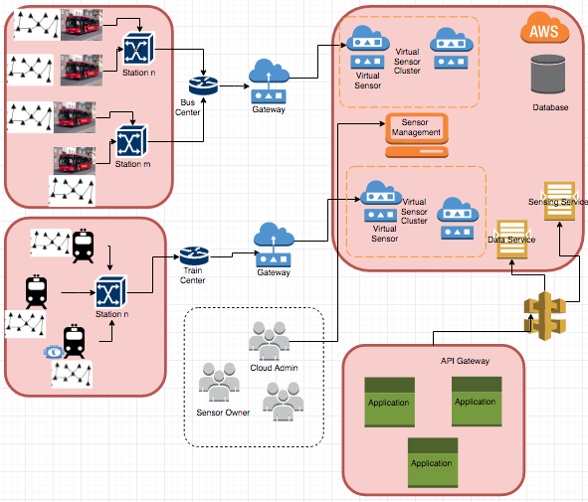
Infrastructure Design
SJSU Washington Square
Notes:
Tran
Bus network
Bus Cloud is deployed to AWS: to utilize its massive scalability and elasticity
Application: web UI or Mobile UI

Slide 5
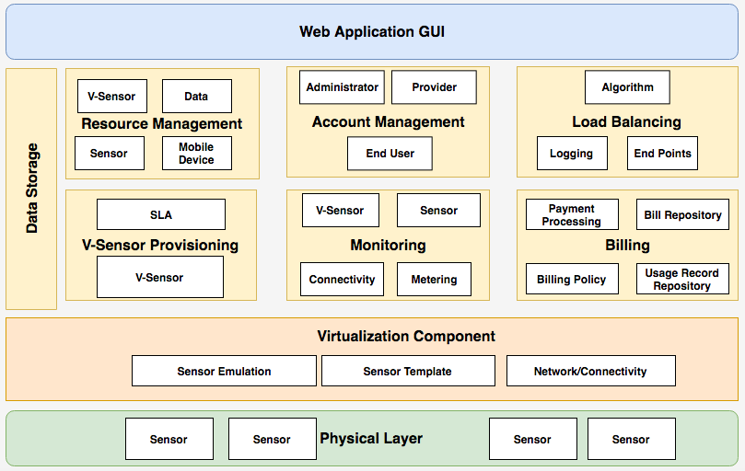
System Components Design
Notes:
Physical Layer
Virtualization Component
Services Component:
V-Sensor provisioning
Monitoring
Data Storage
Billing
Load Balancing
Account Management
GUI: admin, provider, end-user role

Slide 6
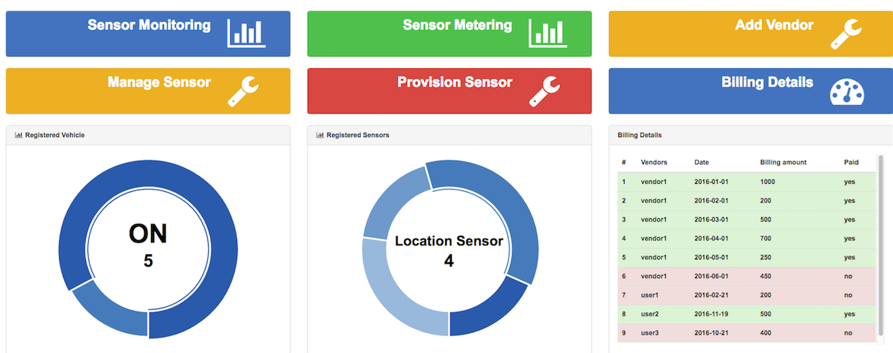

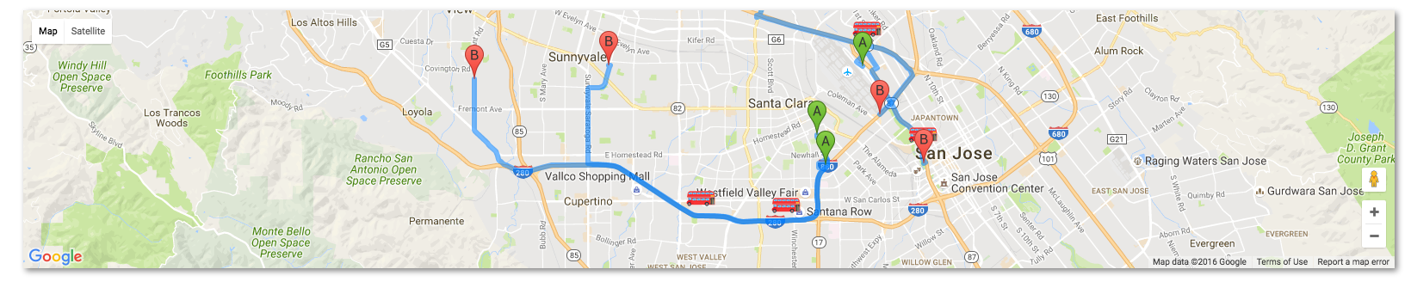
Dashboard
SJSU Washington Square
Notes:
Sneha- We have three type of users for our application - Vendor (who provides the sensor), Admin , Customer (End User). Based on the role of the user different Dashboard is seen once the user Logs in .
Our Dashboard Provides Easy Navigation to the different functionalities of the user and its displayed on the Top part of the dashboard
User Details Like The Number of Registered Vehicles (and their states weather ON or OFF), Number of Registered Sensors, Billing Details etc are displayed in the form Graphs and Table
Dahsboard also Displays a google Map Showing the location of the mobile vehicle and the route its Travelling in

Slide 7
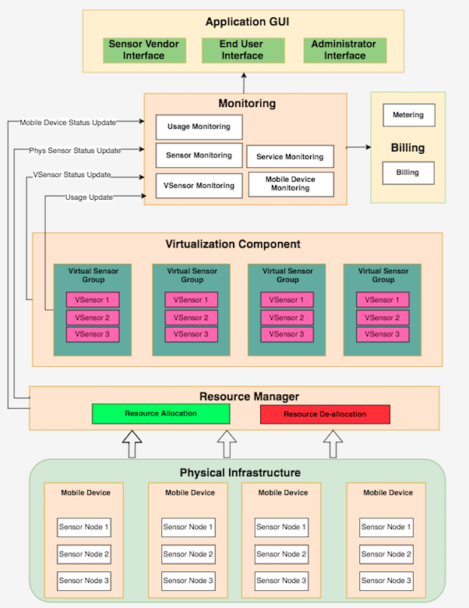
Sensor Monitoring Component Design
Notes:
Sneha -
Monitoring Component provides monitoring details of the sensor -> The input for the monitoring is from 2 sources
1 - Virtualization component - which consists of the details of the virtual sensors
2- Resource Manager - which consists of the details of the Physical Sensors and Devices
Provide status of the sensor, v-sensor and mobile device and their usage to users, which will be the input for billing components.
Base on their role, the component provide 3 different views
Depend on the user role the monitoring interface for each group of user have different functionalities:
The system admin: should be able to monitor the resource usage for billing and sensor state to monitor health.
The end user: should be able to monitor his personal data usage and service consumption.
The sensor network provider should be able to monitor the actual physical state of sensor to perform maintenance, provision and deprovision sensors.

Slide 8
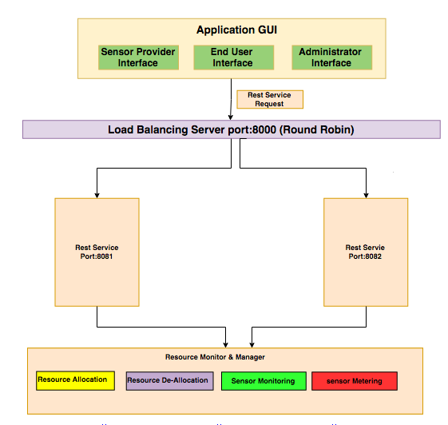
Load Balancer
SJSU Washington Square
Notes:
Sneha - Load Balancing is performed on the Client’s API Requests. The algorithm used to achieve load balancing in Round Robin. Round robin algorithm alternates requests between servers in a stateless manner. In the current setup the application is running on 2 different servers on ports 8081 and 8082 respectively. The load balancer is configured to run on port 8083. The Load Balancer alternately forwards the request to each of the servers. The first Request goes to the server running on port 8081; the second request goes to the server running on port 8082. This is how the load on the servers are balanced.

Slide 9
Virtualization of Sensor Network
SJSU Washington Square
Notes:
Resource Allocation

Slide 10
Sensor Provisioning
SJSU Washington Square
Mapping Relationship of sensors
Multitenancy at Sensor level
Quality of Service
Notes:
Mapping of sensors
Multitenancy
SLA
Quality of Service

Slide 11
Use-case Diagram
SJSU Washington Square
Notes:
Mohamad

Slide 12
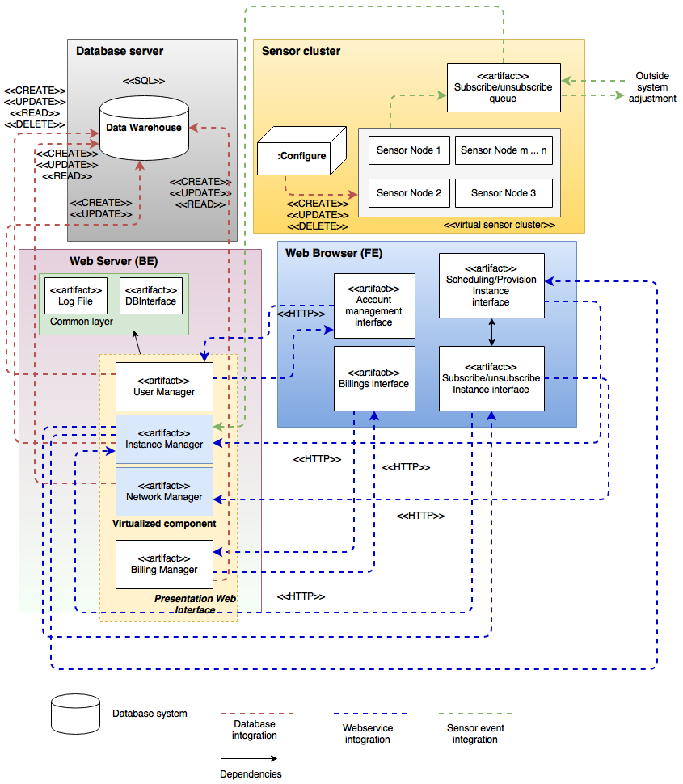
Deployment Design
Notes:
Khanh

Slide 13
Technology stack
MySQL
NodeJS
Sequelize
Express
bcrypt
csrf-crypto
http-proxy
Handlebar
Angular
Bootstrap UI
Notes:
Khanh

Slide 15
Demo
SJSU Washington Square
https://youtu.be/9mgMhlu86yg
Notes:
Khanh

Slide 16


